Slide 1

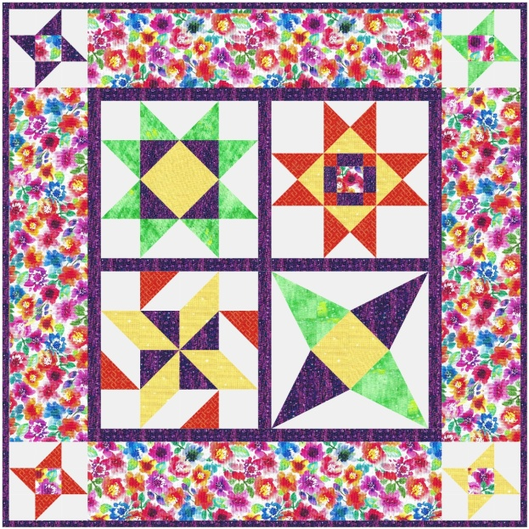

Fabric for Piecing your Dreams Quilt
(the colors stated here are for reference against the picture only! They are not required colors!)
Background (light) White | yard
Color 1 (medium) Yellow | 1/2 yard
Color 2 (dark) Orange | 1/3 yard
Color 3 (medium) Green | 1/3 yard
Color 4 (dark) Purple | 3/4 yard
Floral Border (Med/inspiration) | 1 yard
Total: | 4 yards
Backing | Yards
Batting – 60” wide | 1 1/2 yards
Binding | 1/2 yard
Finished size: 40” x 40”
Required Supplies
Rulers:
8 1/2” x 24 1/2“ Width of Fabric Ruler
Folded Corner Clipper Ruler
Wing Clipper Ruler
Tucker Trimmer Tool
Add a Quarter ruler
Magic Wand tool
Tools:
Sewing machine in good working condition with accurate 1/4” foot and owner’s manual.
Rotary cutting mat (Minimum 18 inch by 24 inch)
Rotary Cutter with a new blade
Sewing Supplies:
Thread
Straight pins
Marking tools
Seam ripper
Cloth and paper scissors
3 ¼”
Template for center applique for Blocks 1 and 4
Quilt Designed by Sherri Colbert and Marcella Phelan; Instructions written by Jody Stultz – Revised 6/2025

