Slide 1
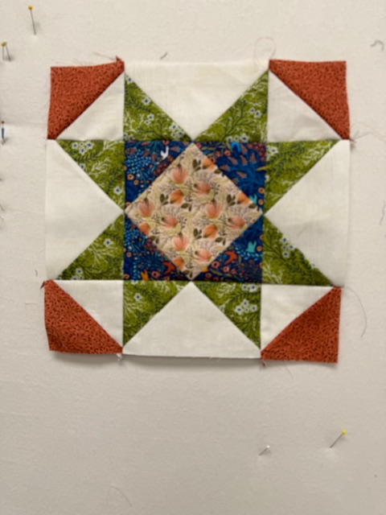
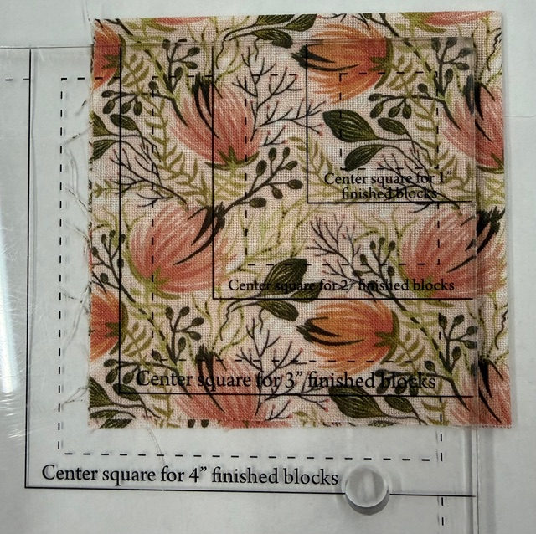
Use the Square Squared Tool to Trim the Peach Fabric to the Correct Size for a 6” Finished Square.
Picture For Illustration Purposes Only.

Slide 2
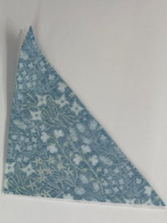
Fold the Dark Blue Fabric in Half & Cut Two 4” Squares. Cut Each Square Diagonally Once to Make 4 HST’s

Slide 3
Sew the Dark Blue Triangles to the Corners of the Peach Square.
Trim to 6-1/2” using the Square Squared Tool.

Slide 4
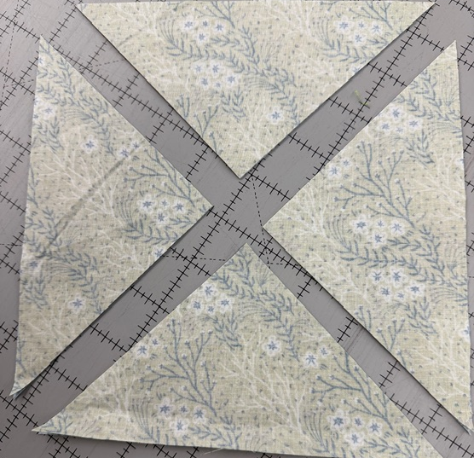
Make the Flying Geese. Cut the Background & Green Squares Twice Diagonally Like an “X”.

Slide 5
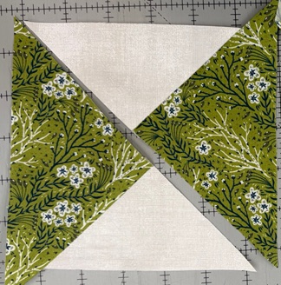
Sew the Resulting QST Triangles Together, Matching the 90-Degree Ends. The Green Triangles Will be Longer than the Backgrounds. Press Toward the Larger Triangles

Slide 6
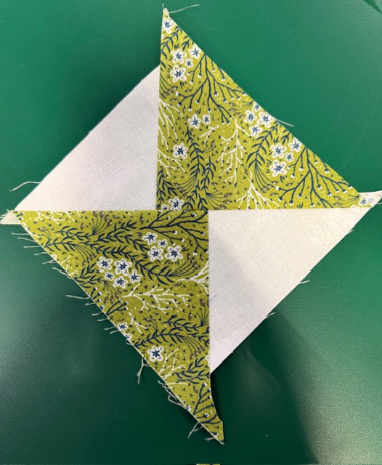
Join the Triangle Sets into Squares.
The Center Seams Do Not Match!

Slide 7
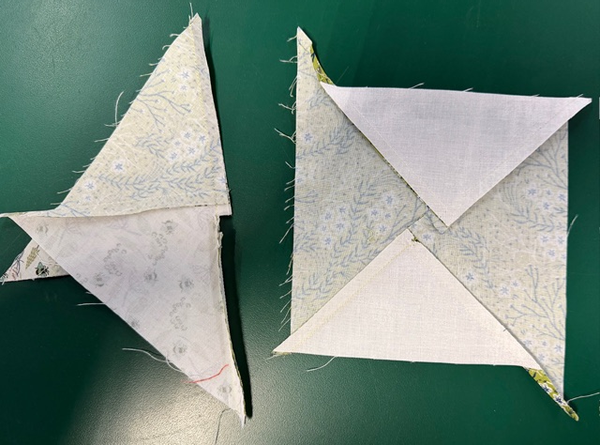
Fold the Unit in Half & Clip the Middle to Break the Stitching in the Seam Allowance.
This Will Allow the Squares to be Pressed Flat, Toward the Larger Triangles.

Slide 8
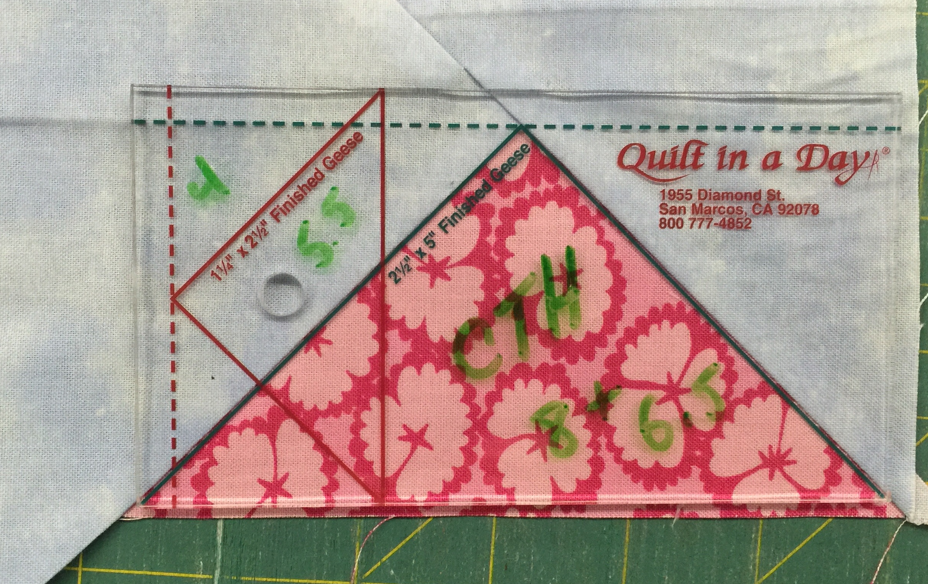
Use the QIAD 3x6 Flying Goose Ruler to Trim the Squares into Four Perfect Flying Goose Units. (Picture is for Technique Illustration Only)

Slide 9
Sew a Set of Flying Geese To Opposite Sides of the Center Square. Green Touches Blue.

Slide 10
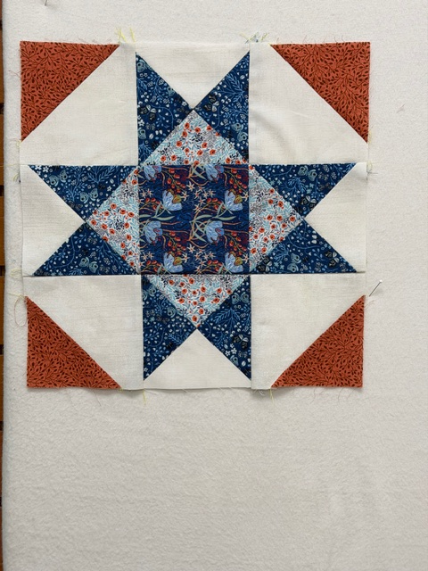
Layer the Orange Fabric With Your Background. Cut Four Sets of 3-1/2” Half Square Triangles. Stitch Together.

Slide 11
Sew an Orange/Background HST Pair to Opposite sides of The Other Flying Goose Units, As Shown, with Orange Corners Facing Out. Make Two Rows

Slide 12
Join Rows. All Done!

